Slide 1
……………………………………………………………………………………………………..
Zero-hours contracts
The latest figures and analysis
Laura Gardiner
April 2014

Slide 2
Exploring zero-hours contracts
……………………………………………………………………………………………………..
Zero-hours contracts (ZHCs)—contracts which do not offer guaranteed hours of work—have been the subject of much recent debate and government consultation
The Office for National Statistics (ONS) quarterly Labour Force Survey captures information on ZHCs in the final quarter of each year. This analysis explores the 2013 data, in comparison to previous years, in order to understand:
1. The prevalence of ZHCs within and across different groups, in comparison to non-ZHC workers
2. The labour market experiences of ZHC workers in comparison to non- ZHC workers: levels of unionisation, underemployment and job search
3. Pay differentials between ZHC and non-ZHC workers across different groups

Slide 3
Limitations of this analysis
……………………………………………………………………………………………………..
When comparing ZHC and non-ZHC workers, we recognise that we are not comparing like with like. Just 2% of workers are on zero-hours contracts, making it statistically impossible to drill down to a level at which we are looking at truly equivalent workers. Instead, we consider differences based on age, industry, occupation and highest qualification level – presenting differences where we find them to be statistically significant to at least a 10% level
This means that we are unable to isolate the impact of ZHCs on pay and labour market experiences. For example, a pay differential between ZHC and non-ZHC workers within a specific qualification level may simply reflect the concentration of ZHC workers, irrespective of qualification, in lower-paying sectors. The sample size is not large enough to consider both conditions at once. The reader should treat the findings as indicative of the pay differentials experienced by ZHC workers for a combination of reasons, rather than as evidence of a pay ‘penalty’ associated with ZHCs
The Labour Force Survey is thought to under-estimate ZHCs because it relies on self-declaration and not all workers realise the terms on which they are employed. The ONS will today publish an alternate estimate of the number of workers on zero-hours contracts based on a survey of businesses rather than worker self-declaration. Nonetheless, the Labour Force Survey remains the best source from which to understand the characteristics of ZHC workers

Slide 4
1 Characteristics of ZHC workers
……………………………………………………………………………………………………..
This section looks at the prevalence of ZHCs within and across different groups, and changes in the composition of ZHC workers in recent years. Specifically, we explore ZHC prevalence by:
Age
Industry
Occupation
Highest qualification level

Slide 5
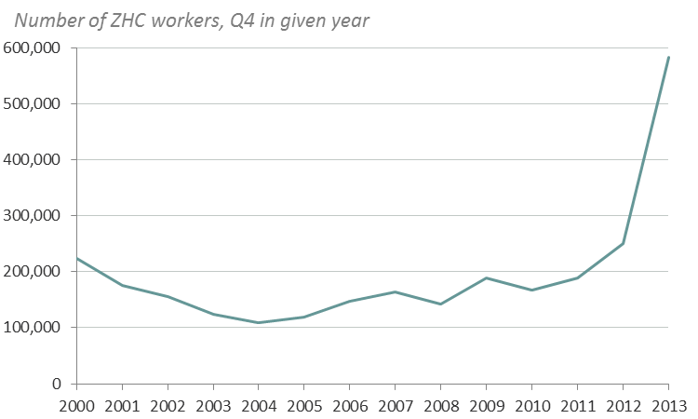
The number of zero-hours workers has more than doubled since 2012
……………………………………………………………………………………………………..
The Q4 2013 estimate from the ONS indicates that 583,000 people are employed on a ZHC in the UK, or just under 2 per cent of the workforce
Source: ONS, Labour Force Survey

Slide 6
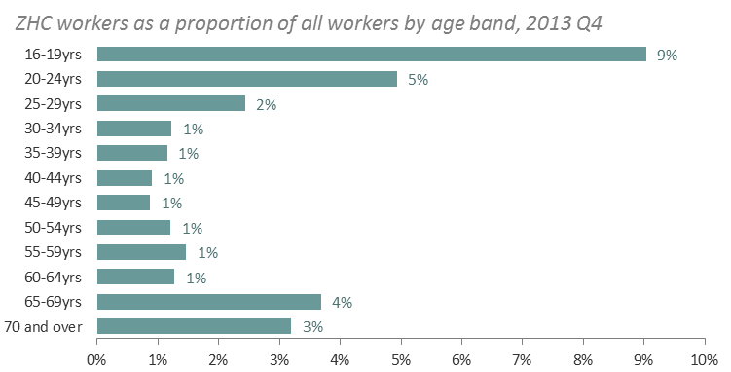
Zero-hours contracts are most prevalent among younger and older workers, and are not just held by students
……………………………………………………………………………………………………..
Across all age groups, just 18% of zero-hours workers are students
Source: ONS, Labour Force Survey

Slide 7
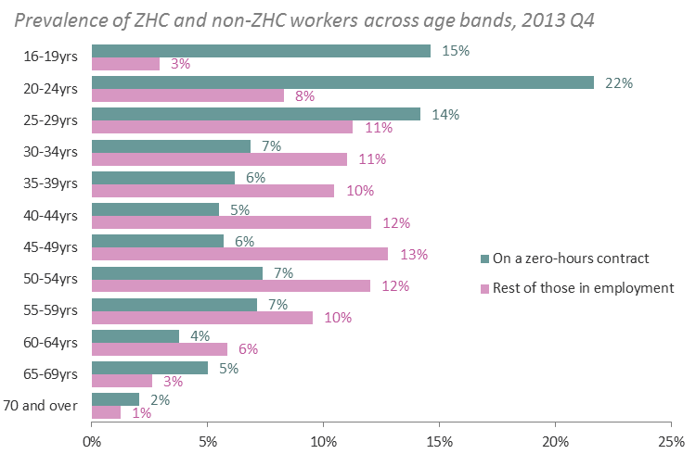
But looking at the distribution of ZHCs across age bands, such workers are concentrated in younger groups
……………………………………………………………………………………………………..
Half (50%) of ZHC workers are aged under 30
Source: ONS, Labour Force Survey. ‘Rest of those in employment’ includes self-employed people

Slide 8
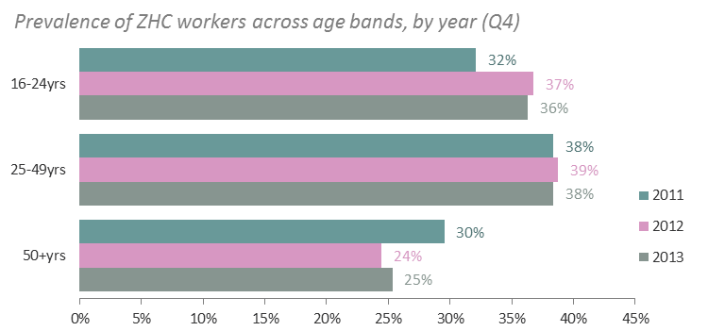
There has been little change in the age profile of ZHC workers in recent years
……………………………………………………………………………………………………..
Despite the overall increase in the number of zero-hours workers, there has been little change in their age profile over time
Source: ONS, Labour Force Survey

Slide 9
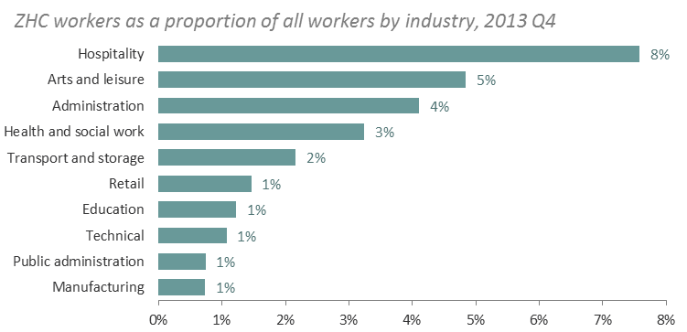
Zero-hours contracts are most prevalent in the hospitality sector
……………………………………………………………………………………………………..
8% of hospitality workers are on a ZHC
The hospitality sector includes those working in hotels, bars and restaurants
Source: ONS, Labour Force Survey

Slide 10
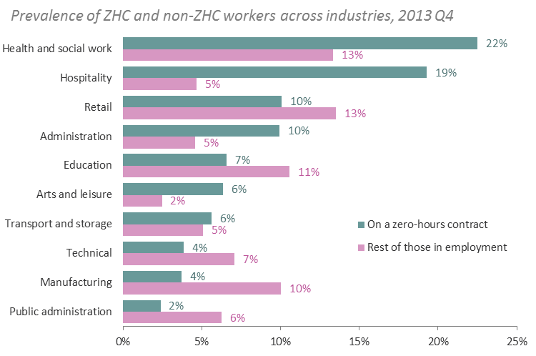
But the highest number of ZHC workers are in the health and social work sector
……………………………………………………………………………………………………..
Health and social work is a much bigger sector overall, which means that it has the largest share of ZHC workers
Source: ONS, Labour Force Survey. ‘Rest of those in employment’ includes self-employed people

Slide 11
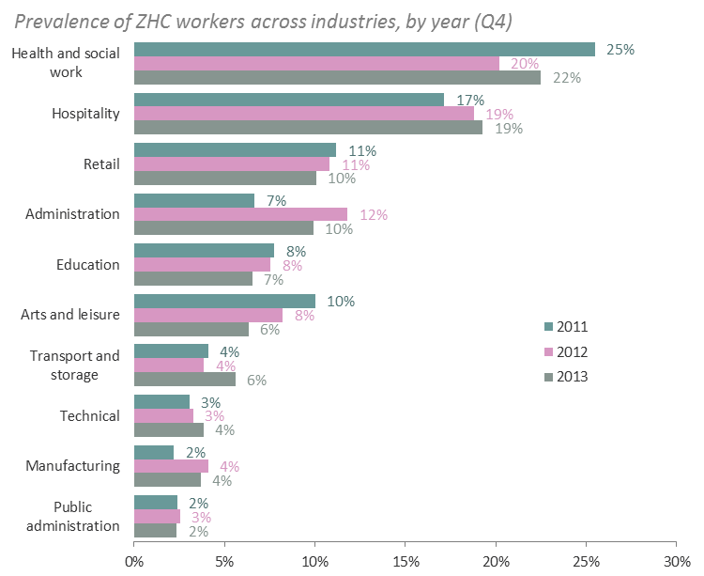
As with the age profile, there has been little change in the industries that those on ZHCs work in
……………………………………………………………………………………………………..
Despite the overall increase in the number of zero-hours workers, there has been little change in their distribution across industries in recent years
Source: ONS, Labour Force Survey

Slide 12
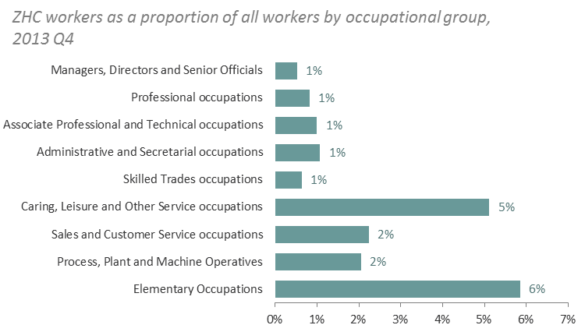
Zero-hours contracts are most prevalent at lower- and middle-skilled occupation levels
……………………………………………………………………………………………………..
Worker in ‘caring , leisure and other personal service occupations’ (including child minders, domiciliary care workers, travel agents and hairdressers) and ‘elementary occupations’ (including unskilled and routine sales, manual and administrative jobs) are most likely to be on ZHCs
Source: ONS, Labour Force Survey

Slide 13
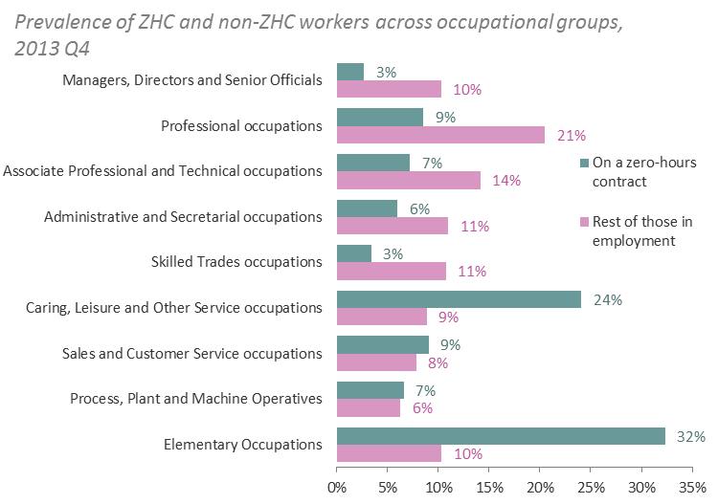
More than half of ZHC workers are employed in caring, leisure and personal services, or elementary occupations
……………………………………………………………………………………………………..
ZHC workers are concentrated at the lower end of the occupational hierarchy, with more than half in either ‘caring, leisure and other personal service occupations’ or ‘elementary occupations’
Source: ONS, Labour Force Survey. ‘Rest of those in employment’ includes self-employed people

Slide 14
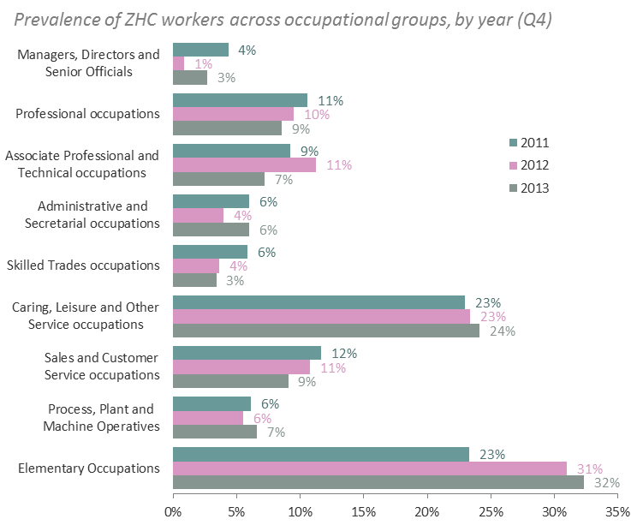
There has been little change in the occupations that those on ZHCs work in
……………………………………………………………………………………………………..
Despite the overall increase in the number of zero-hours workers, there has been little change in their distribution across occupational groups in recent years, with the exception that the share in elementary occupations has increased slightly
Source: ONS, Labour Force Survey

Slide 15
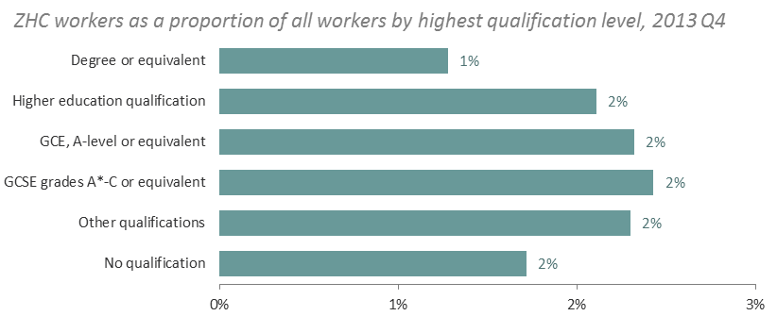
ZHC are prevalent among workers across qualification levels
……………………………………………………………………………………………………..
The chances of being on a ZHC are relatively even across different qualification levels, but highest for those qualified to GCSE or A level
Source: ONS, Labour Force Survey

Slide 16
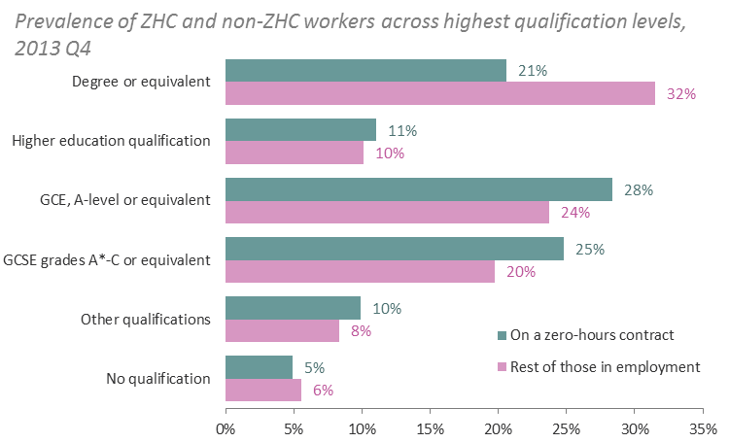
More than half of ZHC workers have GCSEs or A levels as their highest qualification
……………………………………………………………………………………………………..
Workers on ZHCs are disproportionately found at the mid-qualified levels
But one in five have a degree or equivalent qualification
Source: ONS, Labour Force Survey. ‘Rest of those in employment’ includes self-employed people

Slide 17
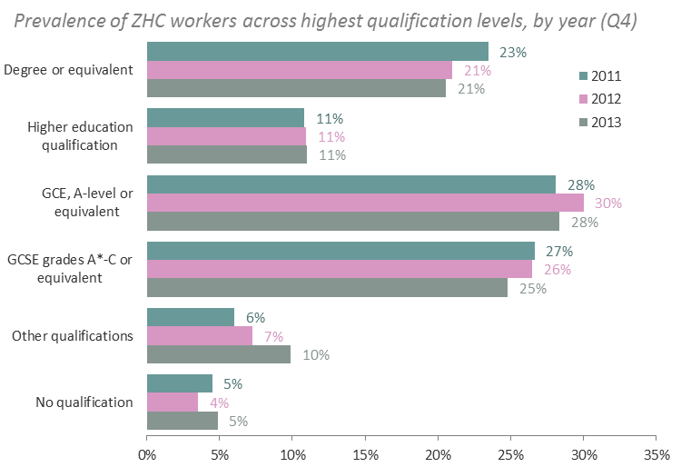
There has been little change in the composition of ZHC workers by qualification
……………………………………………………………………………………………………..
There is some evidence that ZHC workers have become slightly less qualified over time (the proportion with degrees has gone down, and the proportion with ‘other qualifications’ has gone up), but the difference is relatively marginal
Source: ONS, Labour Force Survey

Slide 18
2 Labour market experiences of ZHC workers
……………………………………………………………………………………………………..
This section looks at some features of the labour market experience of ZHC workers: levels of unionisation, underemployment and job search

Slide 19
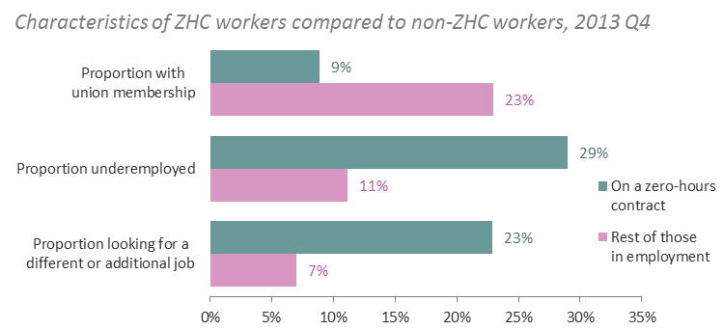
ZHC workers are less likely to be in a union and more likely to be looking for a different or additional job
……………………………………………………………………………………………………..
In this analysis the number of underemployed people is the total of workers who are looking for an additional job, workers who are looking for a different job because they want longer hours, and workers who are not looking for a new job but would like more hours in their current job. There is therefore some overlap between workers who are underemployed and workers who are looking for a different or additional job
Source: ONS, Labour Force Survey. Differences between ZHC and non-ZHC workers are significant at the 1% level

Slide 20
Different levels of unionisation, underemployment and job search among ZHC workers remain within sub-groups
……………………………………………………………………………………………………..
In terms of levels of unionisation, underemployment and job search, differences between ZHC and non-ZHC workers remain within age bands, qualification levels, and the main ZHC industries and occupations
This suggests that the different composition of the ZHC workforce detailed in the previous section – younger, more likely to have GCSEs and A levels, and concentrated in low- and mid-skilled occupations – does not explain all of the overall difference in unionisation, underemployment and job search between ZHC and non-ZHC workers
The annex to this presentation demonstrates this in detail. It shows differences in union membership, underemployment, and rates of searching for a different or additional job between ZHC and non-ZHC workers within age bands, industries, occupational groups and qualification levels

Slide 21
3 Pay differentials
……………………………………………………………………………………………………..
This section looks at the difference in hourly pay rates between ZHC workers and non-ZHC workers (excluding the self-employed, for whom pay data is not collected in the Labour Force Survey). Specifically, we explore pay differentials by:
Age
Industry
Occupation
Highest qualification level
As previously stated, the size of the sample means that we are unable to compare pay levels for truly equivalent ZHC and non-ZHC workers. For example, a pay differential between ZHC and non-ZHC workers within a specific qualification level may simply reflect the concentration of ZHC workers, irrespective of qualification, in lower-paying sectors. The sample size is not large enough to consider both conditions at once. The reader should treat the findings in this section as indicative of the pay differentials experienced by ZHC workers for a combination of reasons, rather than a definitive measure of the pay ‘penalty’ associated with ZHCs. A ZHC pay penalty may persist even if we were able to control for all variables at once, but we have no way of knowing for sure

Slide 22
There is a larger pay differential for ZHC workers aged 25 and over than there is for younger ZHC workers
……………………………………………………………………………………………………..
The difference between the pay of non-ZHC workers and that of ZHC workers is twice as high for those aged 25 and over as it is for the under 25s
Both are smaller than the overall (‘all ages’) pay differential, highlighting the importance of the age composition of the ZHC group. That is, the sizeable overall pay differential between ZHC and non-ZHC workers appears to owe more to the concentration of ZHCs among younger workers (who are typically lower paid than average) than to differences in pay within age groups
Source: ONS, Labour Force Survey. Pay differentials are significant at the 5% level

Slide 23
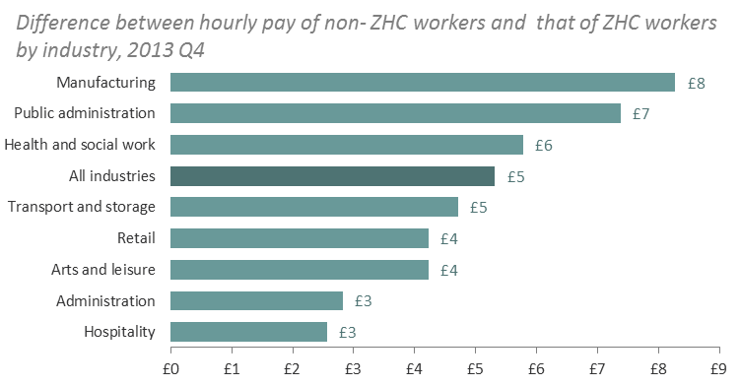
There is a significant pay differential in most of the main ZHC sectors
……………………………………………………………………………………………………..
The pay differential between non-ZHC workers and ZHC workers within industries does not indicate that ZHC workers are paid less for equivalent work, as they are likely to be working at different levels within these industries
However, it confirms that ZHC are concentrated at the lower-paying end of the labour market, both within and across industries
Source: ONS, Labour Force Survey. Pay differentials are significant at the 10% level for all industries displayed

Slide 24
There is a small but significant pay differential for workers in elementary occupations
……………………………………………………………………………………………………..
The ZHC pay differential is much less stark when comparing ZHC and non-ZHC workers in the same broad occupational group
For the 24% of zero-hours workers who work in ‘caring, leisure and other personal service occupations’, there is a pay difference of £1 per hour, but it is not statistically significant
For the 32% of zero-hours workers who work in ‘elementary occupations’, there is a significant pay difference of £1 per hour between ZHC and non-ZHC workers
Source: ONS, Labour Force Survey. The pay differential in ‘elementary occupations’ is significant at the 5% level. The pay differential in ‘caring, leisure and other service occupations’ is not significant. Other occupational groups are not displayed due the low number of ZHC workers in the sample

Slide 25
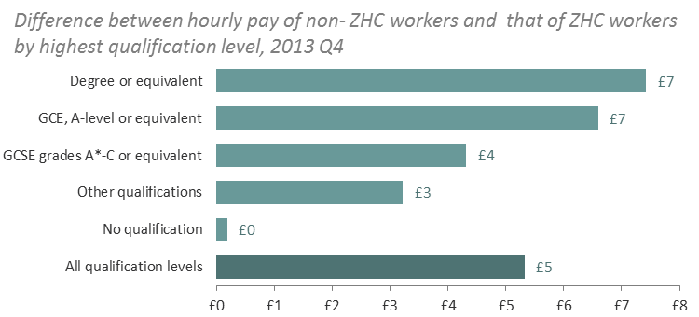
There is a significant ZHC pay differential for those qualified to GCSE level or above
……………………………………………………………………………………………………..
The gap remains significant for those with GCSEs or A levels as their highest qualification if you exclude those currently in education (and therefore possibly working on a ZHC out of convenience to fit around study)
The pay differential between non-ZHC workers and ZHC workers with the same qualifications does not indicate that ZHC workers are paid less for equivalent work: the two groups are not necessarily in comparable jobs as many qualified people work below their skill level
Source: ONS, Labour Force Survey. The pay differential is significant at the 10% level for all qualification levels displayed apart from ‘no qualification’. Higher educational qualifications have been excluded

Slide 26
Conclusions
……………………………………………………………………………………………………..
At the end of 2013 there were an estimated 583,000 workers employed on a ZHC in the UK, just under 2% of the workforce
Workers on ZHCs are younger than non-ZHC workers. They are more likely to have GCSEs and A levels as their highest qualification (though 1 in 5 have degrees); they work in lower-level occupations; and they are concentrated in the health and social work, hospitality, retail and administration sectors
Although the overall number of ZHC workers has gone up, their composition by age, industry, occupation or qualification level has not changed much in recent years
ZHC workers are less likely to be in a union and more likely to be underemployed or looking for a different or additional job than non-ZHC workers. These differences persist when looking within age groups, industries, occupations and highest qualification levels
Previous research has highlighted that zero-hours workers earn less, on an hourly basis, than others in employment. We find evidence that significant pay differentials exist not just at the overall level, but across a number of groups. However, the magnitude of the differential is reduced considerably if we control for age, and if we look within the industries and occupations where ZHC are most prevalent, suggesting that factors other than the contract type are playing a very important role. Nevertheless, the pay differential between non-ZHC workers and ZHC workers remains significant within age groups, industries, at higher qualification levels and in the lowest occupational grouping

Slide 27
Notes on charts
……………………………………………………………………………………………………..
Charts showing ‘ZHC workers as a proportion of all workers’ display the percentage of all of those in employment – within each age band, industry, occupation or highest qualification group – who are on a zero-hours contract. This is equivalent to the likelihood of being on a zero-hours contract in each age band, industry or highest qualification group
Charts showing the ‘prevalence of ZHC and non-ZHC workers’ display the proportion of all zero-hours contract workers that are in each age band, industry, occupation or highest qualification group. This is compared to the proportion of all those in employment who are not on zero-hours contracts in each of these groups. This is equivalent to the distribution of ZHCs (and non-ZHC employment) across age bands, industries or highest qualification groups

Slide 28
……………………………………………………………………………………………………..
Annex
This annex provides further detail on some features of the labour market experience of ZHC workers: levels of unionisation, underemployment and job search. These features are explored within different groups:
Age
Industry
Occupation
Highest qualification level

Slide 29
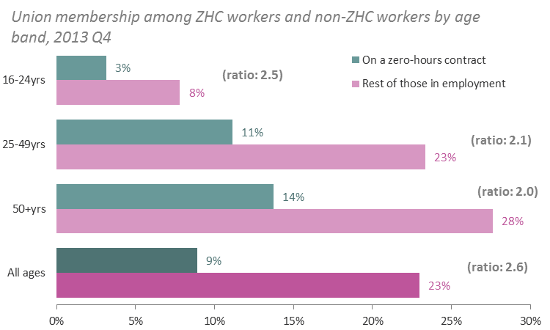
Different rates of union membership between ZHC and non-ZHC workers are upheld within age groups
……………………………………………………………………………………………………..
The relative difference between the rates of union membership of ZHC and non-ZHC workers is similar within each age group to the ‘all ages’ difference
This suggests that the different age composition of the two groups (ZHCs are concentrated among younger workers) is not what’s driving the overall difference in levels of unionisation between ZHC and non-ZHC workers
Source: ONS, Labour Force Survey. Differences between ZHC and non-ZHC workers are significant at the 10% level. Ratios compare the proportion of non-ZHC workers with union membership to the proportion of ZHC workers with union membership within each age band

Slide 30
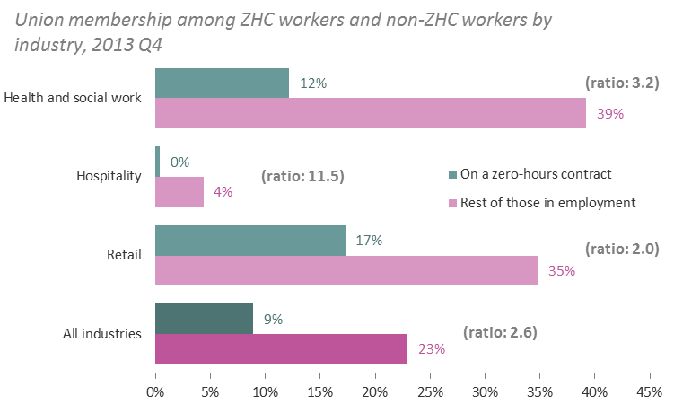
And within the main ZHC industries
……………………………………………………………………………………………………..
The relative difference between the rates of union membership of ZHC and non-ZHC workers is similar within the three main ZHC industries to the overall difference, which suggests that the different industrial composition of the ZHC workforce is not what’s driving the overall difference in union membership
For example, although the hospitality sector has much lower union membership than the average, there remains a clear gap between unionisation of ZHC workers and non-ZHC workers within this industry
Source: ONS, Labour Force Survey. Differences between ZHC and non-ZHC workers are significant at the 10% level for all industries displayed. Only the three main ZHC industries are displayed here, which collectively account for more than half of ZHC workers. Ratios compare the proportion of non-ZHC workers with union membership to the proportion of ZHC workers with union membership within each industry

Slide 31
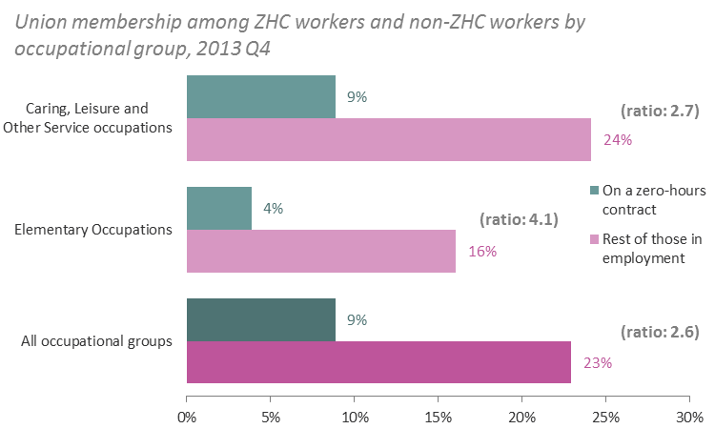
Lower unionisation rates among ZHC workers are also upheld within the main ZHC occupational groups
……………………………………………………………………………………………………..
Proportionally lower rates of union membership among ZHC workers (compared to others in employment) are similar within the two main ZHC occupational groups to the overall difference
This suggests that the different composition of the ZHC workforce (ZHC workers are concentrated in occupations at the lower end of the hierarchy) is not what’s driving the overall difference in union membership
Source: ONS, Labour Force Survey. Differences between ZHC and non-ZHC workers are significant at the 10% level for all occupational groups displayed. Only the two main ZHC occupations are displayed here, which collectively account for more than half of ZHC workers. Ratios compare the proportion of non-ZHC workers with union membership to the proportion of ZHC workers with union membership within each occupational group

Slide 32
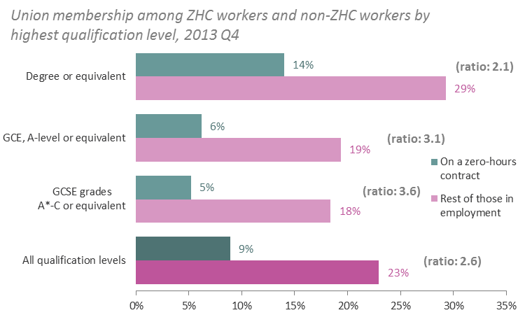
And when comparing workers with the same qualifications
……………………………………………………………………………………………………..
Proportionally lower rates of union membership among ZHC workers (compared to others in employment) are similar to the overall difference within the three most common ZHC highest qualification levels
This suggests that the composition of the ZHC workforce by qualification level is not what’s driving the overall difference in union membership between ZHC and non-ZHC workers
Source: ONS, Labour Force Survey. Differences between ZHC and non-ZHC workers are significant at the 10% level for all qualification levels displayed. Only the three main ZHC qualification levels are displayed here, which collectively account for more than half of ZHC workers. Ratios compare the proportion of non-ZHC workers with union membership to the proportion of ZHC workers with union membership within each qualification level

Slide 33
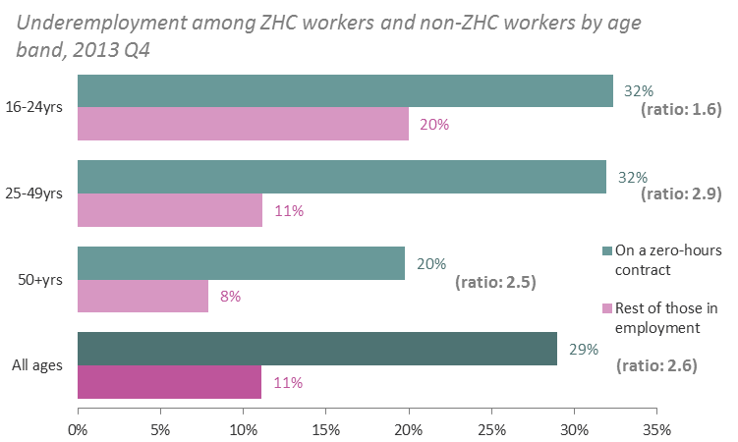
Differences in rates of underemployment between ZHC and non-ZHC workers are similar within age groups
……………………………………………………………………………………………………..
The relative difference between the rates of underemployment of ZHC and non-ZHC workers is similar within each age group to the ‘all ages’ difference, although the margin of difference is smaller for young people
This suggests that the different age composition of the two groups may explain some, but not all, of the overall difference in underemployment between ZHC and non-ZHC workers
Source: ONS, Labour Force Survey. Differences between ZHC and non-ZHC workers are significant at the 10% level. Ratios compare the proportion of ZHC workers who are underemployed to the proportion of non-ZHC workers who are underemployed within each age band

Slide 34
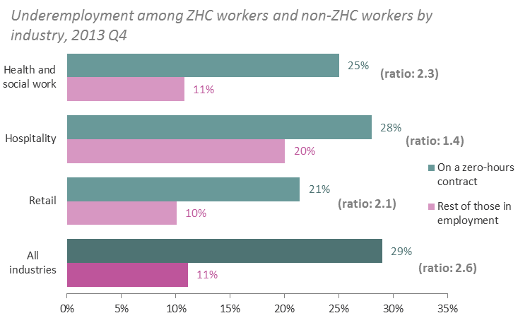
And within the main ZHC industries
……………………………………………………………………………………………………..
The difference between the rates of underemployment of ZHC and non-ZHC workers remains when looking within the three main ZHC industries, which suggests that the different industrial composition of the ZHC workforce is not what’s driving the overall difference in union membership
Source: ONS, Labour Force Survey. Differences between ZHC and non-ZHC workers are significant at the 10% level for all industries displayed. Only the three main ZHC industries are displayed here, which collectively account for more than half of ZHC workers. Ratios compare the proportion of ZHC workers who are underemployed to the proportion of non-ZHC workers who are underemployed within each industry

Slide 35
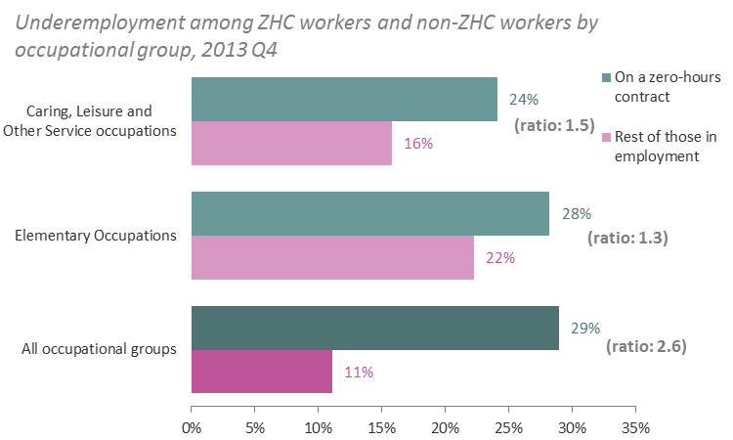
The relationship continues to hold within the main ZHC occupational groups
……………………………………………………………………………………………………..
Higher rates of underemployment among ZHC workers (compared to others in employment) are present within the two main ZHC occupational groups, although the gap is smaller than the overall difference
This suggests that the different composition of the ZHC workforce (ZHC workers are concentrated in occupations at the lower end of the hierarchy) may explain some, but not all, of the overall difference in underemployment levels between ZHC and non-ZHC workers
Source: ONS, Labour Force Survey. Differences between ZHC and non-ZHC workers are significant at the 10% level for all occupational groups displayed. Only the two main ZHC occupations are displayed here, which collectively account for more than half of ZHC workers. Ratios compare the proportion of ZHC workers who are underemployed to the proportion of non-ZHC workers who are underemployed within each occupational group

Slide 36
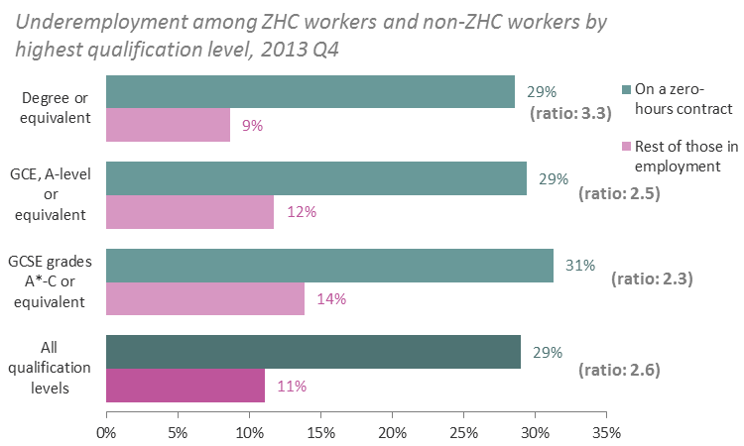
And when comparing those with the same qualifications
……………………………………………………………………………………………………..
Proportionally higher rates of underemployment among ZHC workers (compared to others in employment) are similar to the overall difference within the three most common ZHC highest qualification levels
This suggests that the composition of the ZHC workforce by qualification level is not what’s driving the overall difference in underemployment between ZHC and non-ZHC workers
Source: ONS, Labour Force Survey. Differences between ZHC and non-ZHC workers are significant at the 10% level for all qualification levels displayed. Only the three main ZHC qualification levels are displayed here, which collectively account for more than half of ZHC workers. Ratios compare the proportion of ZHC workers who are underemployed to the proportion of non-ZHC workers who are underemployed within each qualification level

Slide 37
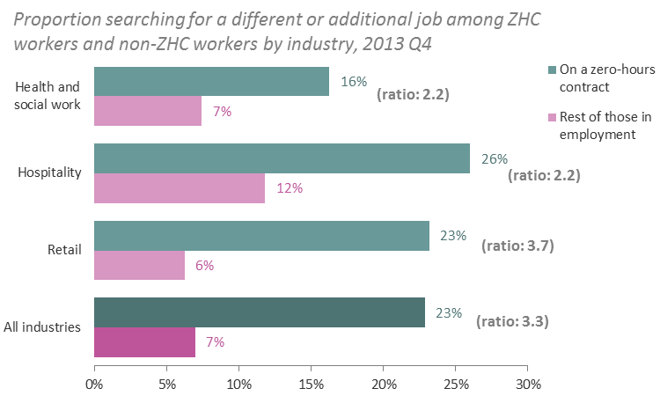
Differences in job search rates between ZHC and non-ZHC workers are similar within age groups
……………………………………………………………………………………………………..
The difference between the proportion of ZHC and non-ZHC workers looking for a different or additional job is similar within each age group to the ‘all ages’ difference
This suggests that the different age composition of the two groups explains little of the overall difference in job search rates between ZHC and non-ZHC workers
Source: ONS, Labour Force Survey. Differences between ZHC and non-ZHC workers are significant at the 10% level. Ratios compare the proportion of ZHC workers who are searching for a different or additional job to the proportion of non-ZHC workers who are searching for a different or additional job within each age band

Slide 38
And within the main ZHC industries
……………………………………………………………………………………………………..
The difference between the rate of ZHC and non-ZHC workers looking for a different or additional job remains when focusing within the three main ZHC industries, although the gap is slightly smaller within health and social work and hospitality
This suggests that the different industrial composition of the ZHC workforce is not what’s driving the overall difference in job search
Source: ONS, Labour Force Survey. Differences between ZHC and non-ZHC workers are significant at the 10% level for all industries displayed. Only the three main ZHC industries are displayed here, which collectively account for more than half of ZHC workers. Ratios compare the proportion of ZHC workers who are searching for a different or additional job to the proportion of non-ZHC workers who are searching for a different or additional job within each industry

Slide 39
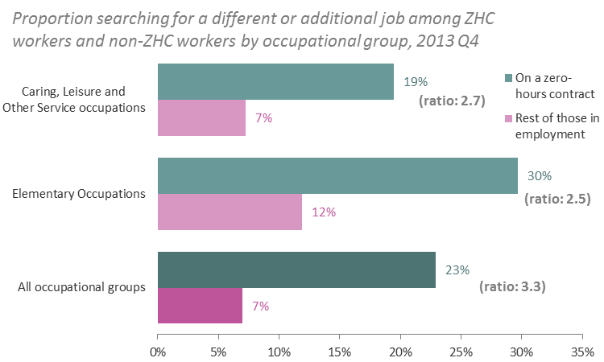
Higher job search rates among ZHC workers are also present within the main ZHC occupational groups
……………………………………………………………………………………………………..
Higher rates those looking for a different or additional job among ZHC workers (compared to others in employment) are present within the two main ZHC occupational groups
This suggests that the different composition of the ZHC workforce (ZHC workers are concentrated in occupations at the lower end of the hierarchy) explains little of the overall difference in job search levels between ZHC and non-ZHC workers
Source: ONS, Labour Force Survey. Differences between ZHC and non-ZHC workers are significant at the 10% level for all occupational groups displayed. Only the two main ZHC occupations are displayed here, which collectively account for more than half of ZHC workers. Ratios compare the proportion of ZHC workers who are searching for a different or additional job to the proportion of non-ZHC workers who are searching for a different or additional job within each occupational group

Slide 40
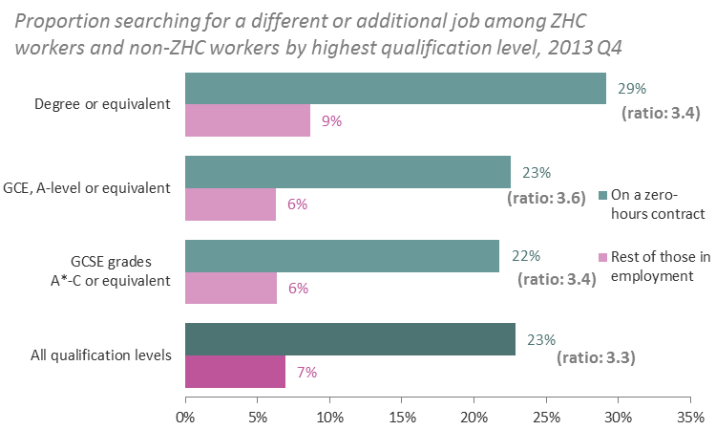
And the relationship persists when comparing those with the same qualifications
……………………………………………………………………………………………………..
Proportionally higher rates of those searching for a different or additional job among ZHC workers (compared to others in employment) are similar to the overall difference within the three most common ZHC highest qualification levels
This suggests that the composition of the ZHC workforce by qualification level is not what’s driving the overall difference in job search rates between ZHC and non-ZHC workers
Source: ONS, Labour Force Survey. Differences between ZHC and non-ZHC workers are significant at the 10% level for all qualification levels displayed. Only the three main ZHC qualification levels are displayed here, which collectively account for more than half of ZHC workers. Ratios compare the proportion of ZHC workers who are searching for a different or additional job to the proportion of non-ZHC workers who are searching for a different or additional job within each qualification level

