Slide 1
……………………………………………………………………………………………………..
Closer to the Edge?
Prospects for household debt repayments as interest rates rise
July 2013
www.resolutionfoundation.org
@resfoundation
#ukdebt

Slide 2
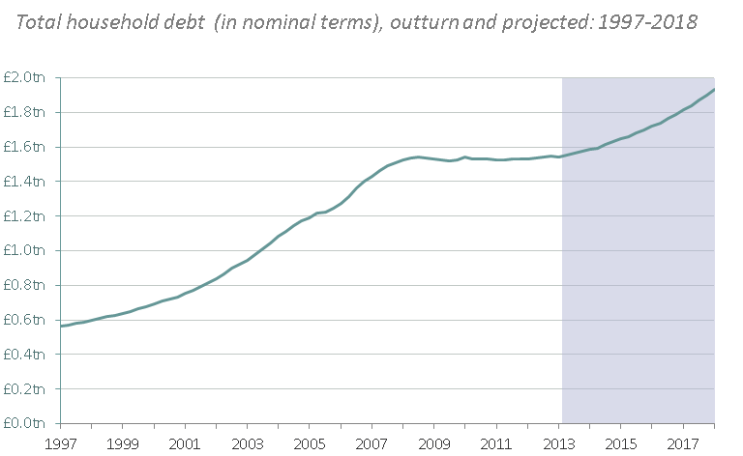
Borrowing has been flat in cash terms (falling in real) since 2008 due to a combination of falling demand for, and supply of, credit
Borrowing is now projected to rise, with Funding for Lending and Help to Buy potentially reducing deposit requirements
Total debt projected to start rising again, approaching £2 trillion by 2018
……………………………………………………………………………………………………..
Source: ONS, National Accounts (outturn) and OBR, Economic and Fiscal Outlook, March 2013 (projection)
#ukdebt

Slide 3
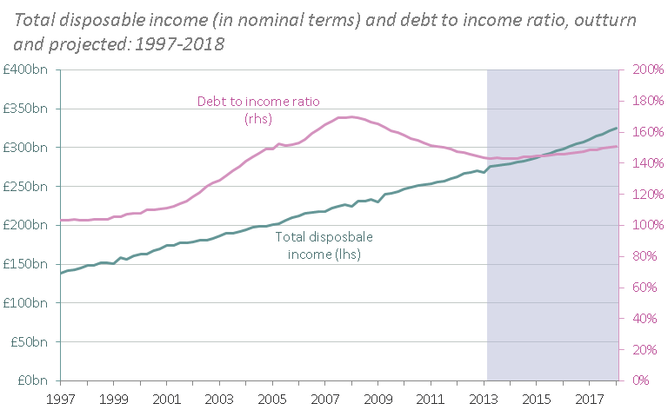
Rather than falling back to historic levels, the debt to income ratio is projected to increase slightly between today and 2018, rising from 143% to 151%, equivalent to its 2005 level
Resulting in a slight increase in the debt-to-income ratio, returning it to its 2005 level
……………………………………………………………………………………………………..
Source: ONS, National Accounts (outturn) and OBR, Economic and Fiscal Outlook, March 2013 (projections)
#ukdebt

Slide 4
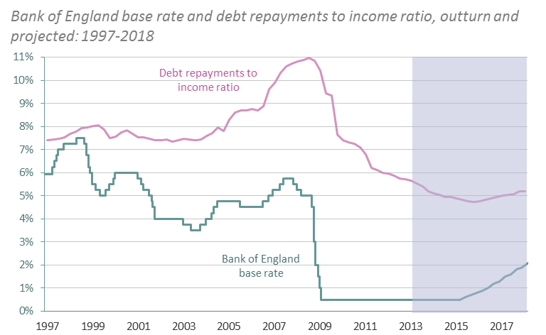
Market expectations (and the new Governor’s comments) suggest that the base rate will remain close to the floor for a few more years
The burden of debt repayments is therefore projected to be broadly flat
But continued low borrowing costs mean the debt repayment ratio is projected to remain flat
……………………………………………………………………………………………………..
Source: Bank of England and (outturn) and OBR, Economic and Fiscal Outlook (outturn & projection)
#ukdebt

Slide 5
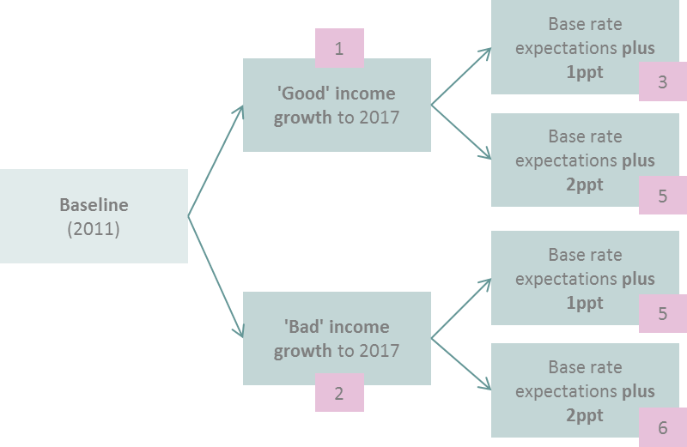
‘Good’ income growth assumes that household income growth is strong and even (tracking GDP and being quite evenly distributed)
‘Bad’ income growth assumes household income growth is weak and uneven
(falling behind GDP and being skewed towards more affluent households)
Producing six scenarios that consider different paths for income growth and borrowing costs
……………………………………………………………………………………………………..
#ukdebt

Slide 6
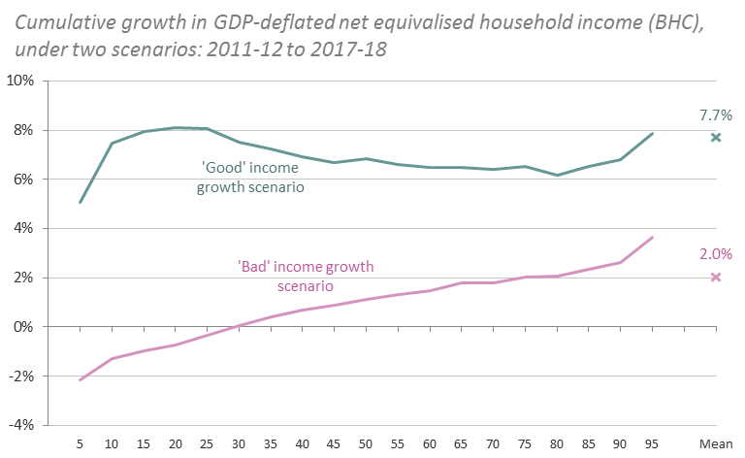
The ‘good’ scenario combines past benchmarks for strong and even household income growth (meaning overall real growth of 7.7%)
The ‘bad’ scenario combines past benchmarks for weak and uneven household income growth
We create ‘good’ and ‘bad’ income scenarios: strong and even vs. weak and uneven
……………………………………………………………………………………………………..
Growth rates apply to equivalised incomes; the scenario model uses unequivalised rates of growth.
#ukdebt

Slide 7
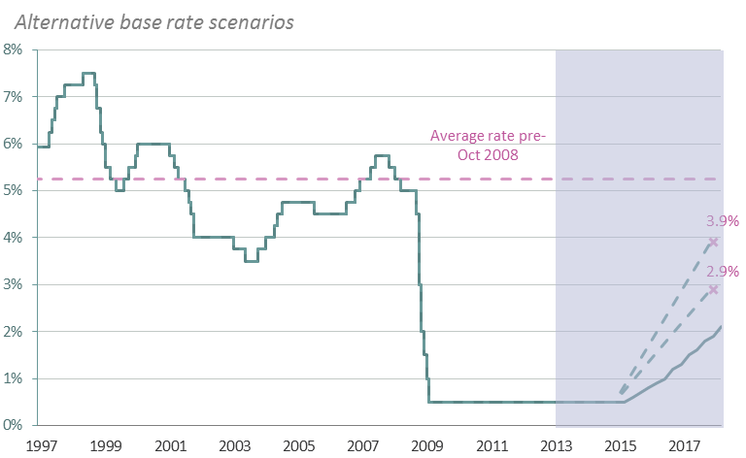
Current market expectations suggest that the base rate will rise slowly from 2015, reaching 1.9% by 2017
Under both the ‘good’ and ‘bad’ income scenarios, we consider the impact of rates rising by a further 1ppt or 2ppt over the period
We test two alternatives to the default base rate path, above expectations but well below normal level
……………………………………………………………………………………………………..
Source: Bank of England (outturn) and OBR, Economic and Fiscal Outlook (projection)
#ukdebt

Slide 8
Our scenario impact assessment focuses on the affordability of servicing debts in the coming years
……………………………………………………………………………………………………..
We previously identified 3.6 million ‘debt loaded’ households in 2012
  households spending more than ¼ of their disposable income on debt repayments
To judge the impact of different income growth and interest rate scenarios, we now consider the number of households falling into ‘debt peril’
  households spending more than ½ of their disposable income on debt repayments (often taken to be an indicator of over-indebtedness)
#ukdebt

Slide 9
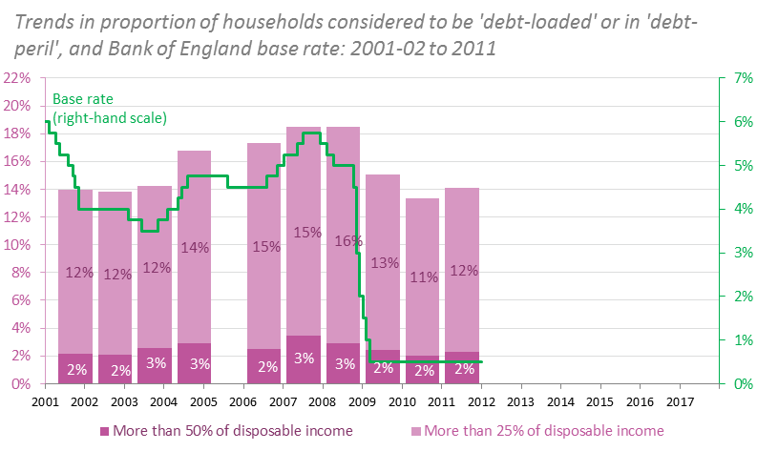
The proportion of households in ‘debt peril’ peaked at over 3% in 2007, just prior to the financial crisis
With the base rate at a historic low, the proportion fell to around 2% in 2011 (and may be a little lower still today)
The numbers of households in ‘debt peril’ has fallen since 2007, thanks to ultra-loose monetary policy
……………………………………………………………………………………………………..
#ukdebt

Slide 10
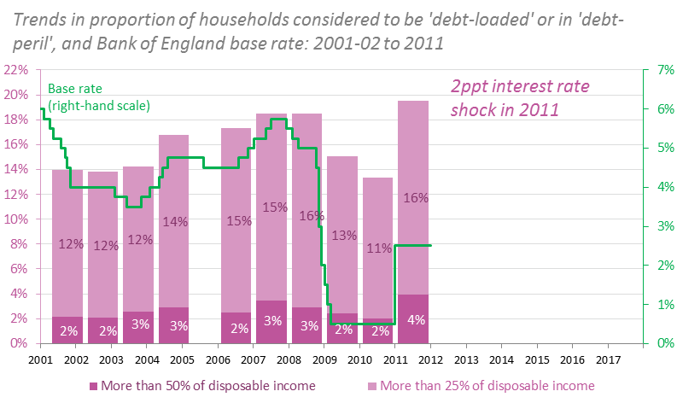
A 2ppt overnight increase in the base rate would push 4% of households into debt peril
Clearly this cannot happen, but illustrates the level of sensitivity to interest rates and the importance of the current monetary stance
Clearly an increase in interest rates today would push large numbers of households into peril
……………………………………………………………………………………………………..
#ukdebt

Slide 11
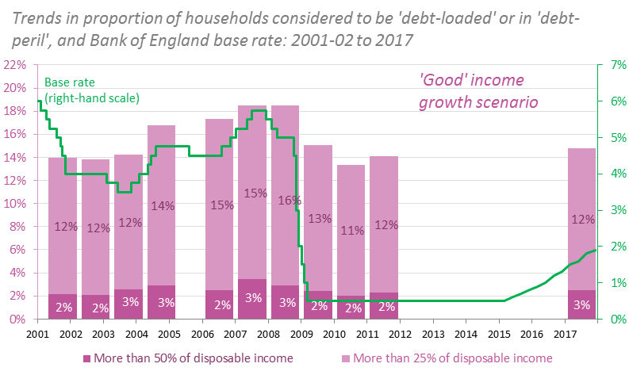
Taking an optimistic view about income growth – that it keeps pace with GDP and is evenly shared – the proportion of households in peril would increase slightly to just under 3%
Under ongoing low rates and good household income growth, exposure to debt is broadly constant
……………………………………………………………………………………………………..
#ukdebt

Slide 12
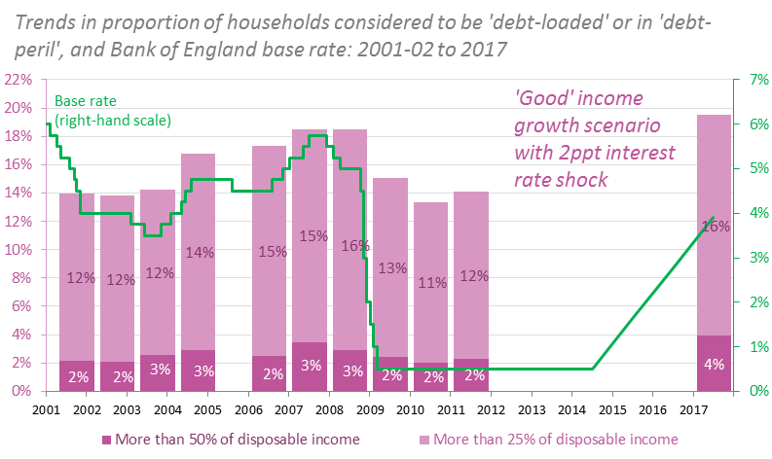
A 2ppt interest rate shock (above current market expectations) would leave the base rate below its pre-crisis level, but would increase the proportion of households in ‘debt peril’ to around 4%
With relatively modest increase potentially pushing large numbers of households into ‘debt peril’
……………………………………………………………………………………………………..
#ukdebt

Slide 13
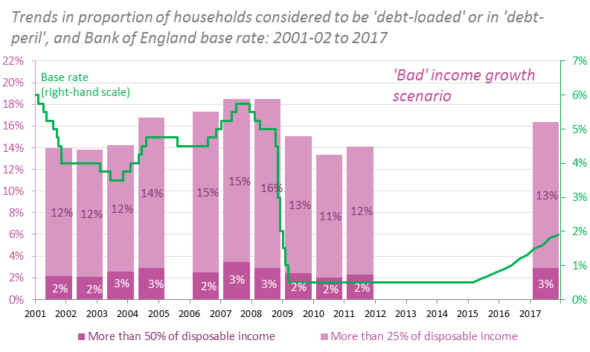
Returning to the market expectation trajectory for the base rate but applying the ‘bad’ income growth scenario would raise the proportion of households in ‘debt peril’ to around 3%
Under the ‘bad’ income growth scenario, numbers in peril grow even in the absence of interest rate shocks
……………………………………………………………………………………………………..
#ukdebt

Slide 14
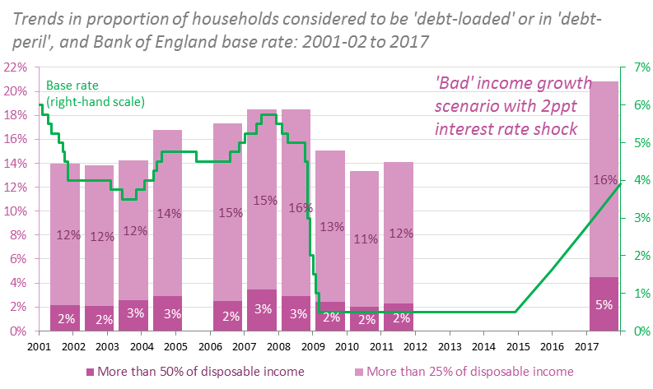
Under the worst (yet still plausible) of our scenarios, the proportion of households in ‘debt peril’ would jump to around 5%, more than double the baseline level and significantly higher than the levels recorded even at the start of the crisis
With a 2ppt interest rate shock contributing to a doubling of ‘debt peril’ levels relative to today
……………………………………………………………………………………………………..
#ukdebt

Slide 15
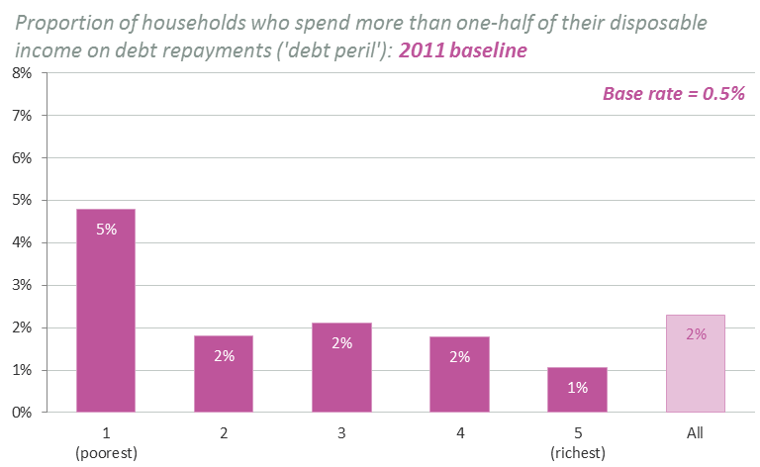
In the 2011 baseline, around 5% of households in the bottom fifth of the income distribution were in ‘debt peril’
In contrast, just 1% of households in the top fifth were in this position
‘Debt peril’ is most prevalent at the bottom of the income distribution
……………………………………………………………………………………………………..
#ukdebt

Slide 16
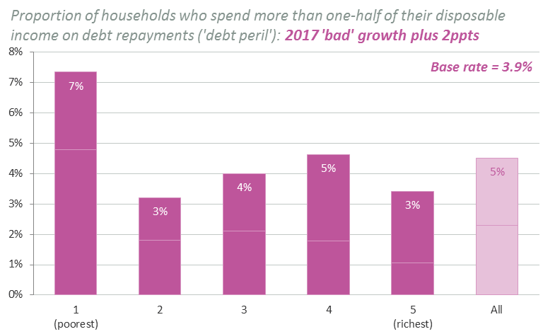
The weak growth in overall household incomes underpinning the ‘bad’ growth scenario means that the numbers affected in this instance rise significantly across the entire distribution
Prevalence remains twice as high in the bottom quintile as in the top
‘Bad’ income growth generates further – relatively uniform – increases in peril across the distribution
……………………………………………………………………………………………………..
#ukdebt

Slide 17
……………………………………………………………………………………………………..
Closer to the Edge?
Prospects for household debt repayments as interest rates rise
July 2013
www.resolutionfoundation.org
@resfoundation
#ukdebt

